Slide 1

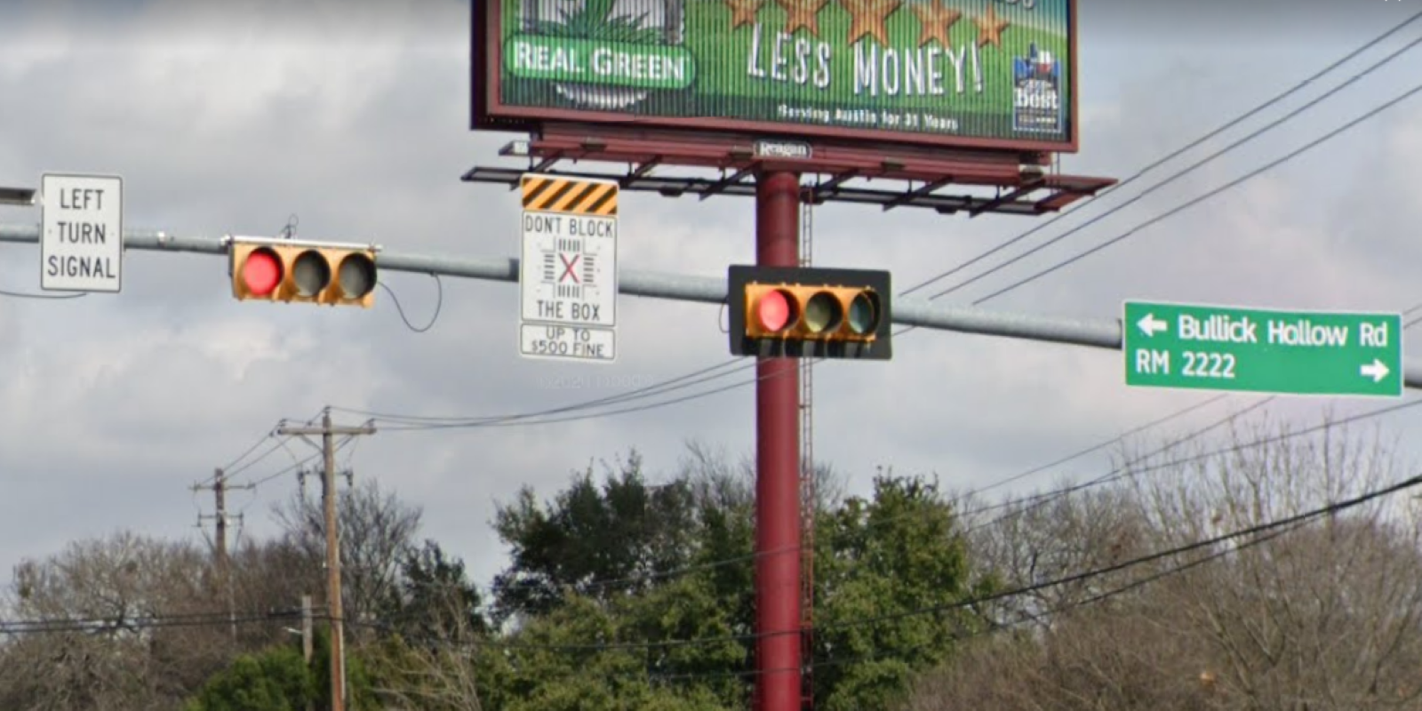
Austin Transportation Department Signs Work Orders
Created By: Susanne Gov Created Date: 2020-08-10 Location Name: FM 620 RD / 2222 RD Intersection ID: 5145335 Cardinal Direction: N
Sign Type | Install/Remove
Street Name Sign | Install
Don’t Block the Box | Install
Left Turn Signal | Install

Slide 2
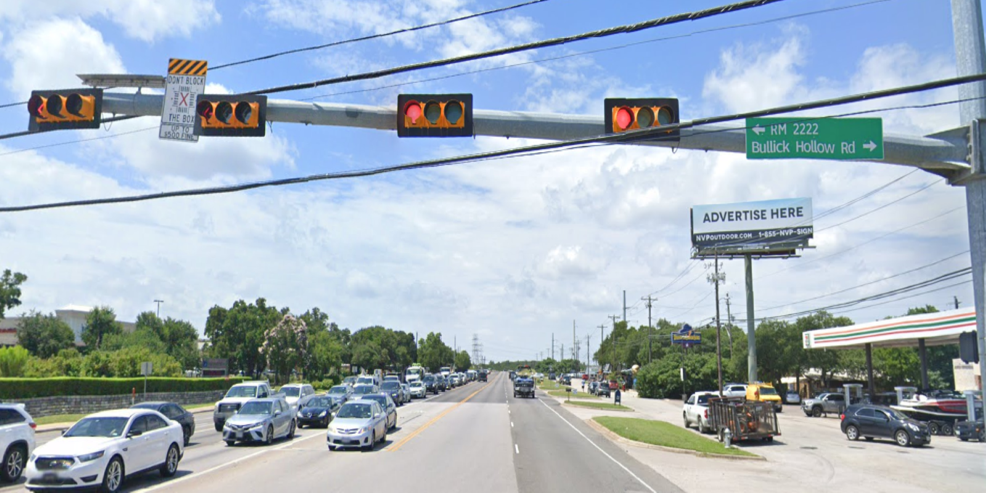
Austin Transportation Department Signs Work Orders
Created By: Susanne Gov Created Date: 2020-08-10 Location Name: FM 620 RD / 2222 RD Intersection ID: 5145335 Cardinal Direction: S
Sign Type | Install/Remove
Street Name Sign | Install
Don’t Block the Box | Install

Slide 3
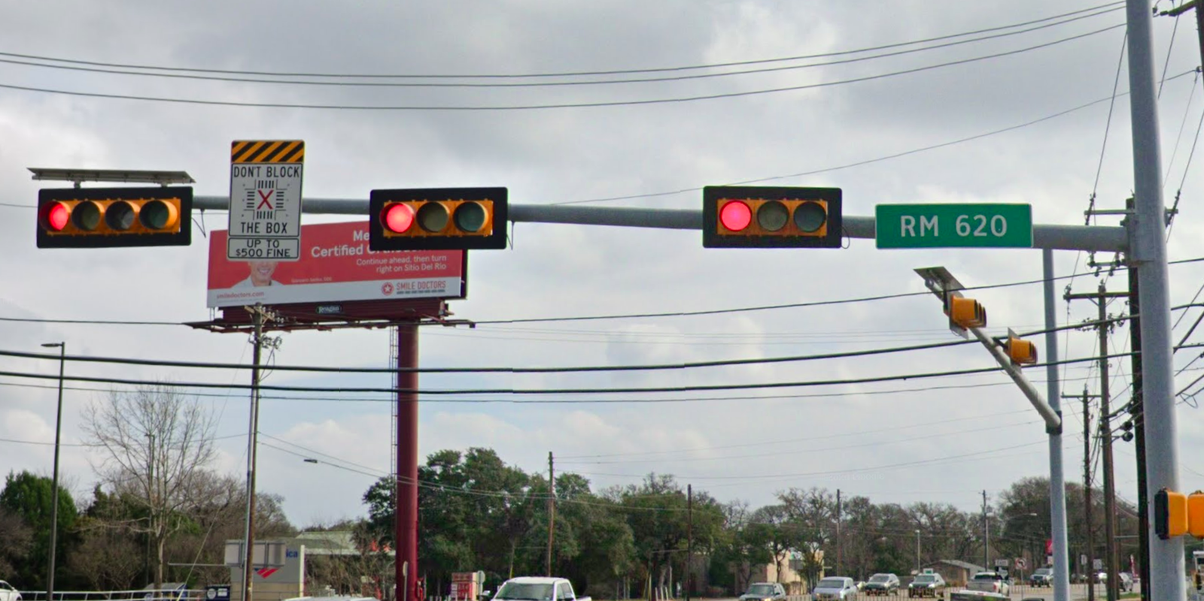
Austin Transportation Department Signs Work Orders
Created By: Susanne Gov Created Date: 2020-08-10 Location Name: FM 620 RD / 2222 RD Intersection ID: 5145335 Cardinal Direction: E
Sign Type | Install/Remove
Street Name Sign | Install
Don’t Block the Box | Install

Slide 4
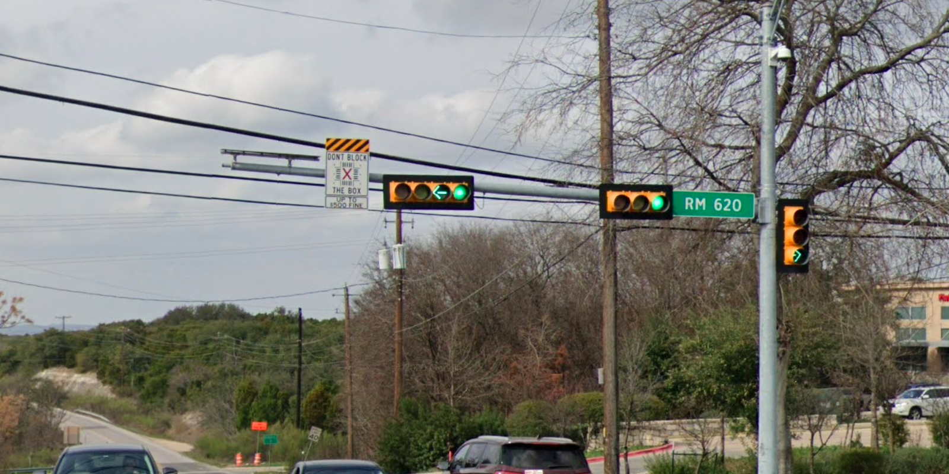
Austin Transportation Department Signs Work Orders
Created By: Susanne Gov Created Date: 2020-08-10 Location Name: FM 620 RD / 2222 RD Intersection ID: 5145335 Cardinal Direction: W
Sign Type | Install/Remove
Street Name Sign | Install
Don’t Block the Box | Install

